Slide 1

Outside Novel Reading Assignment: A Year Long Process
“The more that you read, the more things you will know. The more that you learn, the more places you'll go.”
― from I Can Read With My Eyes Shut!

Slide 2
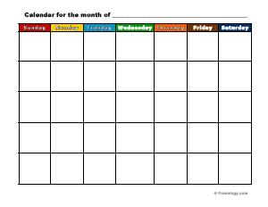
“Year Long” Concept
Fiction
    Poetry
        Play
  Informative Nonfiction
        Persuasive Nonfiction
            Argumentative Research Paper

Slide 3

Fiction Connection: Reading Comprehension
Choose a FICTION novel that you want to read.
Must be at least 150 pages long.
Must be age appropriate (avoid Jr. High section).
ALL books must be approved.
Culminating project will be assigned at a later date.

Slide 4

Poetry Connection:
Finding and Writing Poetry
Students will be required to create a “FOUND POEM” using the novel previously read.
Students will be asked to reflect upon the novel previously read and find an accompanying poem. A short essay response will be required connecting the book to the poem. A copy of the chosen poem is required.

Slide 5

Play Connection:
Reconstructing a Scene
Students will be asked to pull a scene from the novel previously read and recreate it using the set up like a play using stage directions for creating mood/tone and action as is necessary for understanding the scene. A copy of the original text should accompany the submitted script.

Slide 6
Information Nonfiction Connection: Educating Us
Students will find a topic within the previously read novel and educate the class in a presentation.
This activity will be used as a precursor to the research paper, teaching students how to research using the library databases as well as taking digital notes.

Slide 7

Persuasive Nonfiction: Convince Me
Students will be asked to reflect on their previously read novel and to write a full persuasive essay without research.

Slide 8

Argumentative Research Paper:
Educate and Persuade Me
Students will take the previously written persuasive essay and add research using the library databases and digital note-taking skills.

