Slide 1
EOC/STAAR TUTORIALS
Tutorial times: Before, Activity Period, and After
Reading Analysis – Mondays – 3/16, 23
Essay –Tuesdays - 3/17, 24
Short Answer – Wednesdays - 3/18, 25
Revising and Editing – Thursdays - 3/19, 26

Slide 2
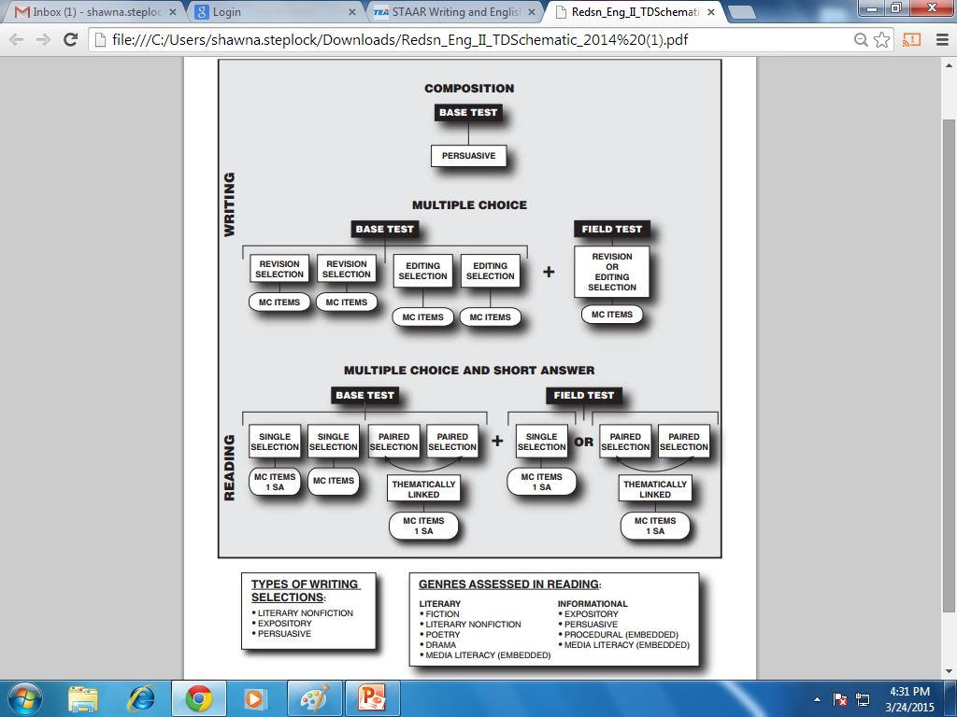
Breaking Down the Test

Slide 3
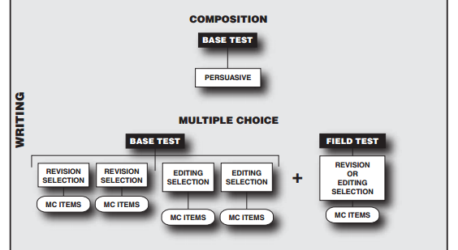
Writing Portion

Slide 4
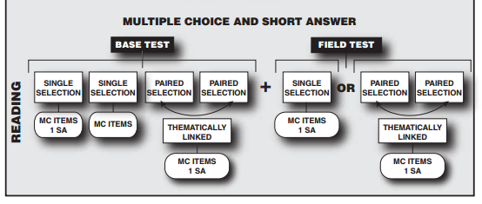
Reading Portion

Slide 5
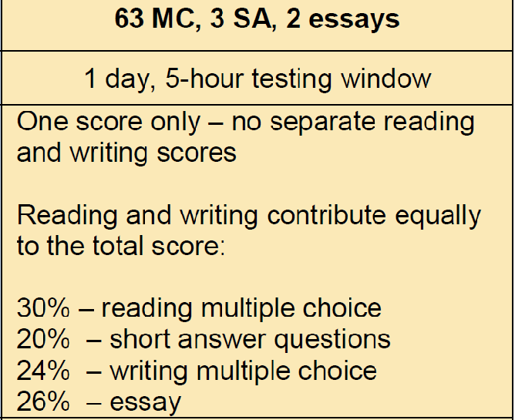
Breaking Down the Test - %

